Slide 1
BANKING
MANAGEMENT
SYSTEM
FRONT END WEB DEVELOPMENT
By using HTML, CSS and JavaScript
By: SIDDHANT SHARMA
ECE
40796502818

Slide 2
CONTENTS
INTRODUCTION
HTML
CSS
JAVASCRIPT
GLIMPSE OF PROJECT
CONCLUSION

Slide 3
INTRODUCTION
Banking Management System helps us to keep a record of the transactions we do in our life. "Banking Management System" demo project in HTML , It consist of a login form, new account opening form, transaction details, fund transfers option and view balance.
Objectives of such a type of Banking System is:
To keep data user protected and allow only authorize person to access it.
Make system more comfortable for public by reducing pen and paper work.
Saving Time and bringing more transparency in system.

Slide 4
HTML
Hypertext Markup Language (HTML) is the standard markup language for creating web pages and web applications. Web browsers receive HTML documents from a web server or from local Storage and render them into multimedia web pages. HTML describes the structure of a web page and originally included cues for the appearance of the document.

Slide 5
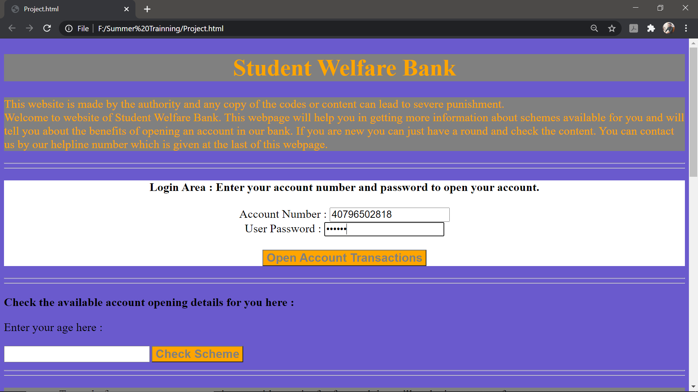
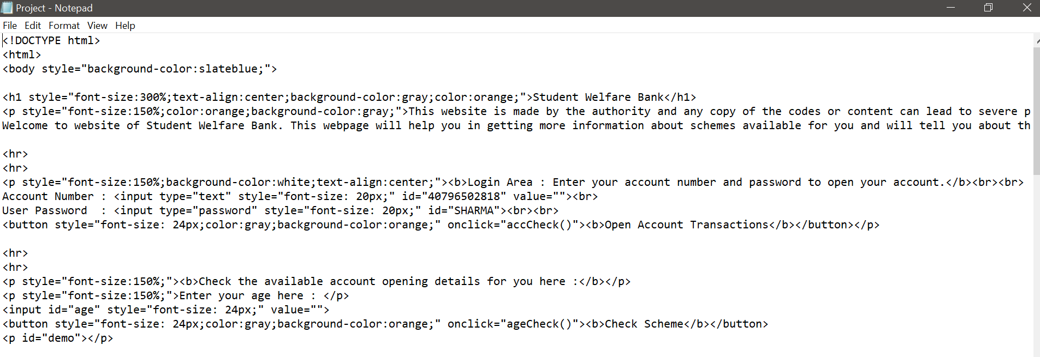

Slide 6
CSS
Cascading Style Sheets (CSS) is a style sheet language used for describing the presentation of a document written in a markup language. Although most often used to set the visual style of web pages and user interfaces written in HTML.

Slide 7
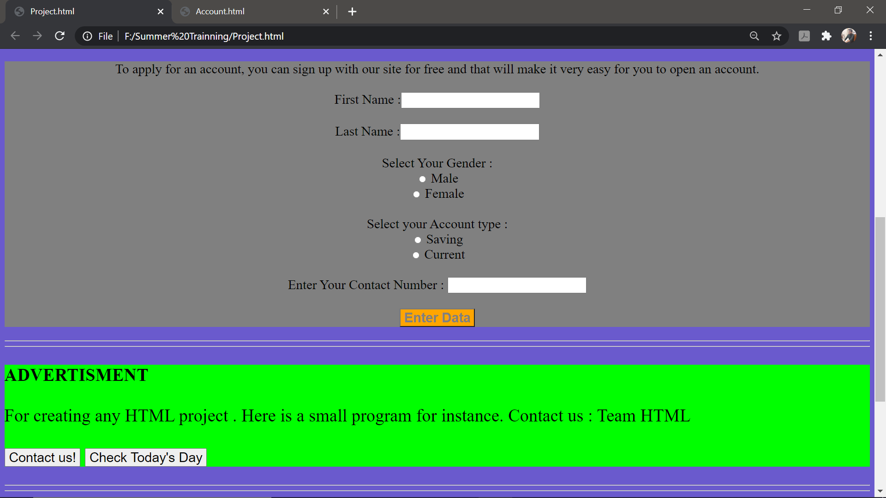
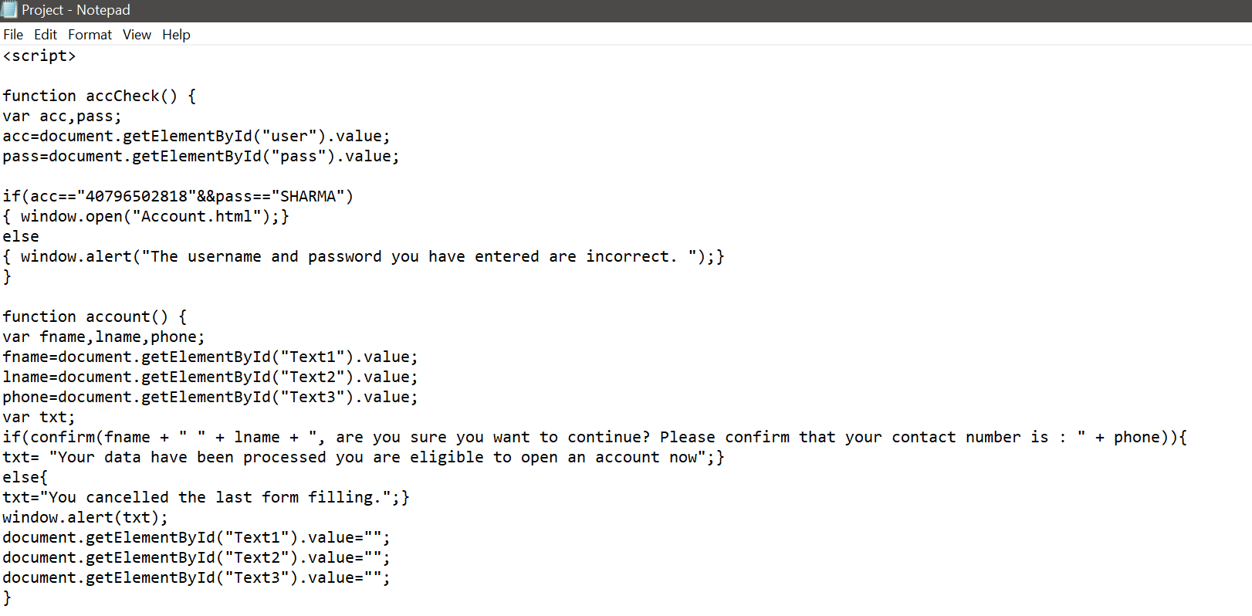

Slide 8
JAVASCRIPT
JavaScript often abbreviated as JS, is a high-level, interpreted programming language . It is a language which is also characterized as dynamic, weakly typed, prototype-based and multi-paradigm.

Slide 9
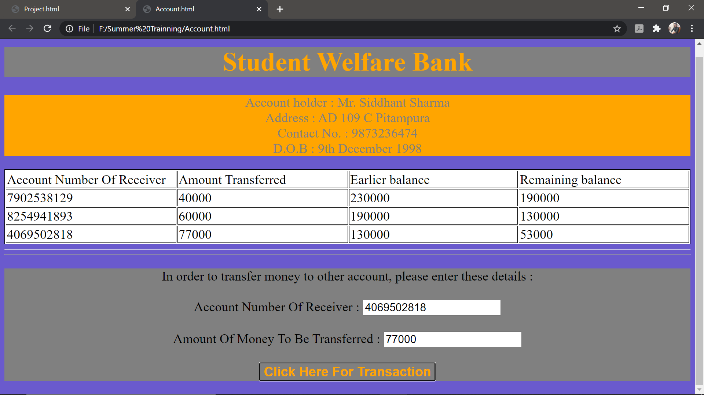
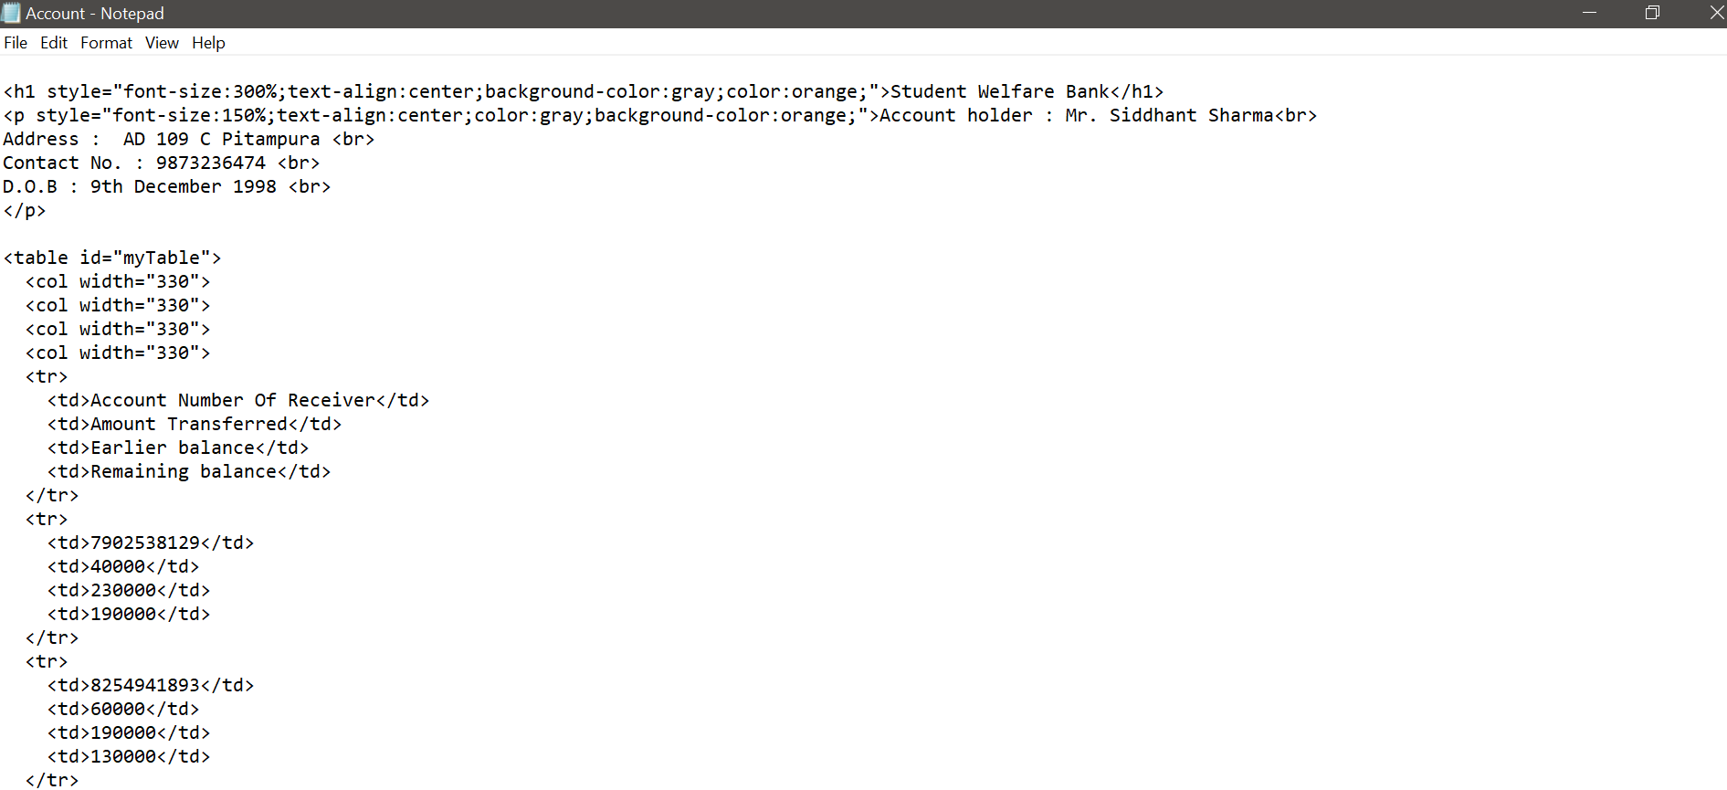

Slide 10
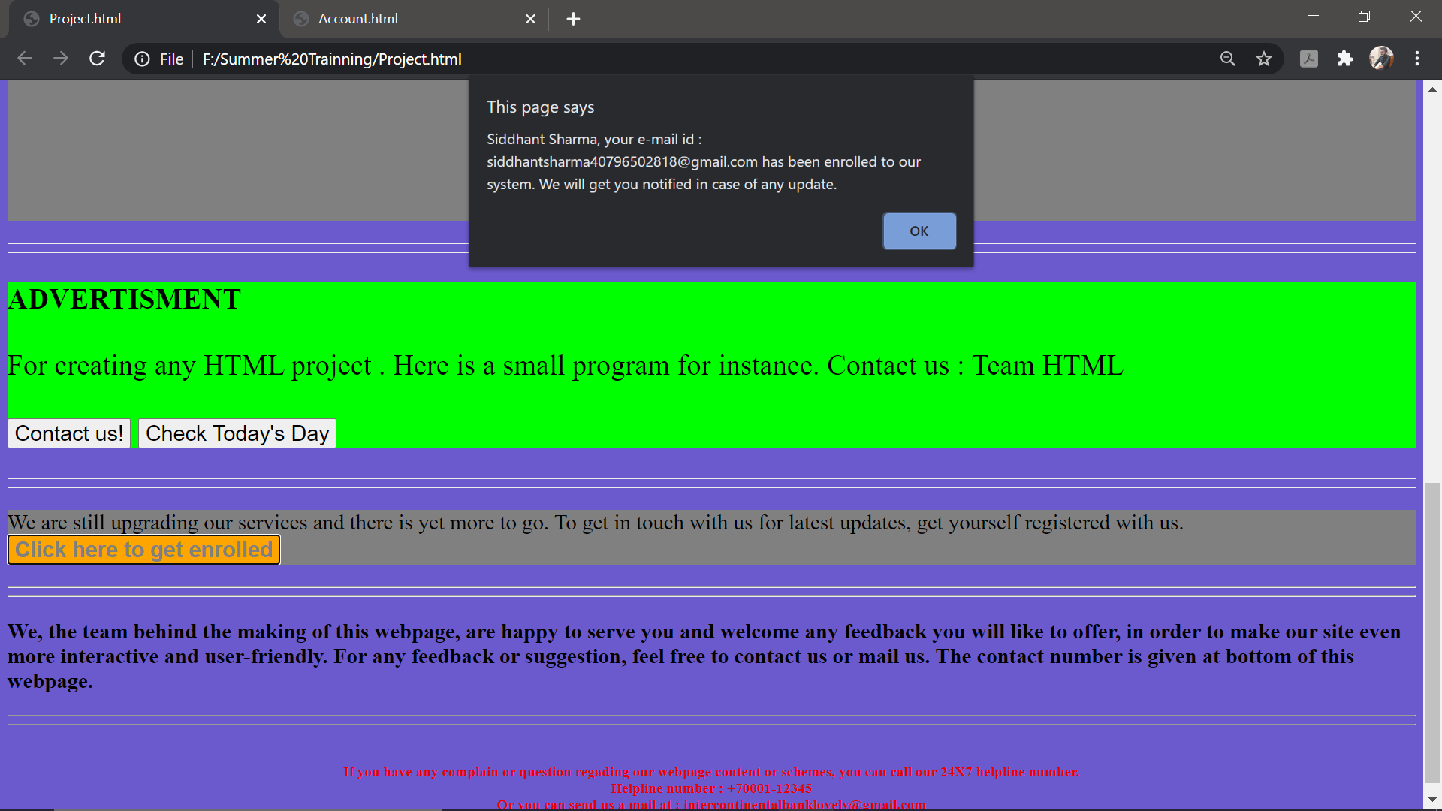
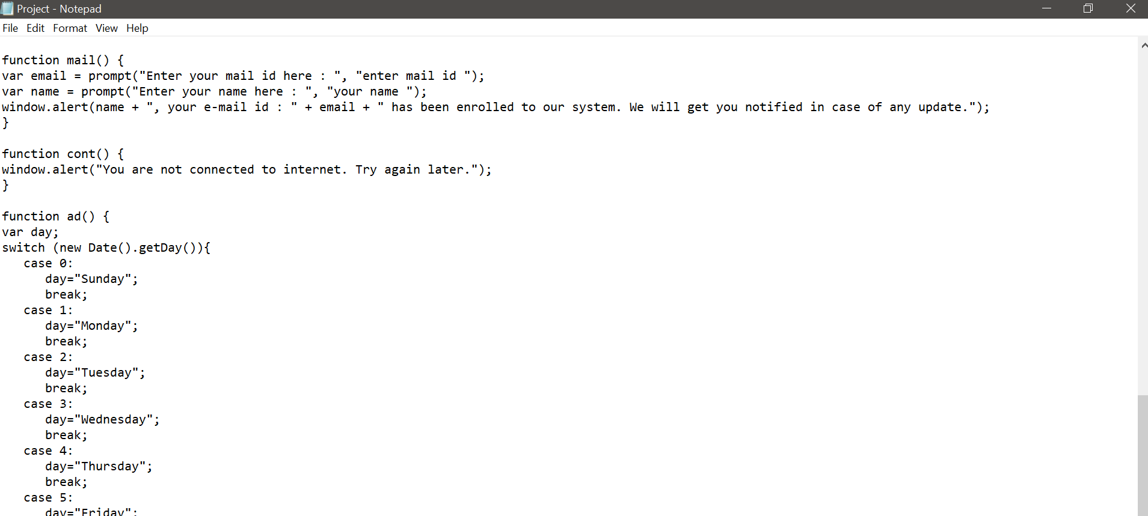

Slide 11
CONCLUSION
At last I would like to conclude by saying that, Web Development is a very vast subject and I have done a small project on it which have helped us to understand the basics of the subject. The advanced technologies in Banking System are being applied by the various National Banks and a significant amount of development can be seen which helped its customers.

Slide 12
THANKS A LOT

